Slide 1
Spring FRAMEWORK
By Ashish Chopra
E2open Pvt Ltd.

Slide 2

Introduction
Developed By Rod Johnson in Feb 2003.
Spring is an open source framework.
Used for J2EE application development.
Spring is lightweight when it comes to size and transparency.
Used by million of developers across the world.

Slide 3
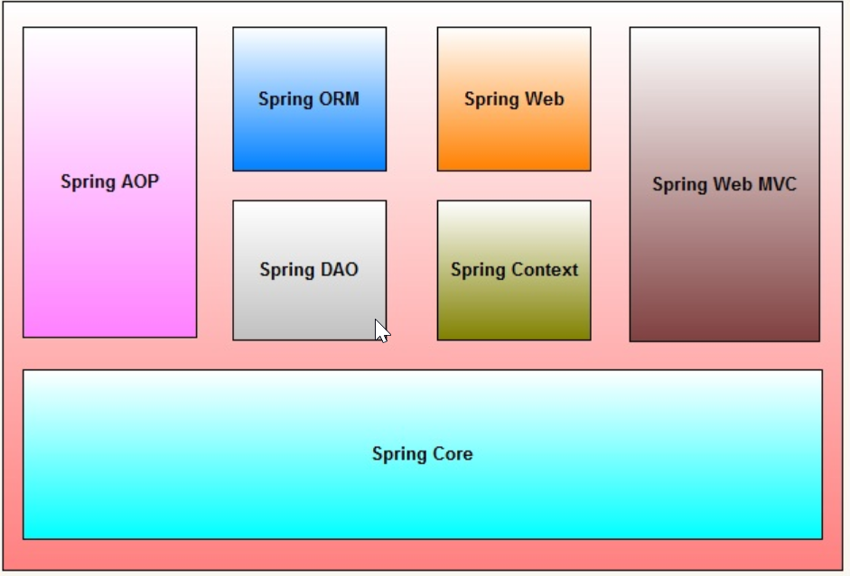
Spring ARCHITECTURE

Slide 4
Dependency injection
Instead of Objects invoking another objects, the dependent objects are added through an external entity.
Also known as the Hollywood principle – “don’t call us, we’ll call you.”
Dependencies are injected by container during runtime.
Prevents hard-coded object creation.
Loose Coupling.
Helps write effective unit tests.

Slide 5


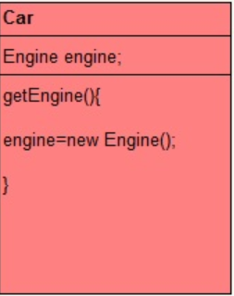
Without di
Example :
We have two classes car and engine.
Many ways to instantiate an object.
Here we are instantiating with new operator.

Slide 6
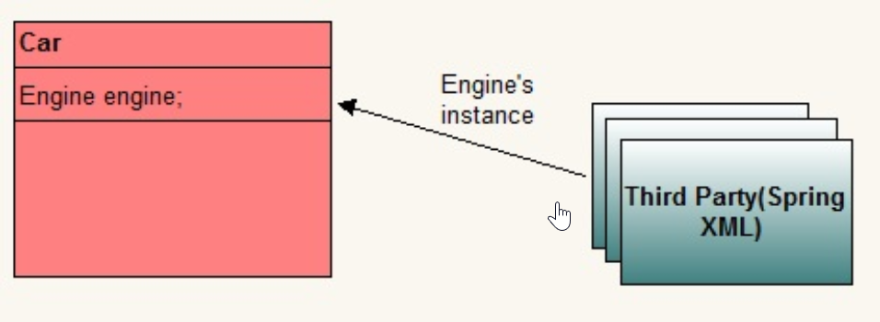
With help of di
Outsource instantiation and supply job of instantiation to third party.
Dependency between car and engine is injected by a third party.
Whole agreement involves some configuration information too.

Slide 7
Spring Beans
In Spring, POJO’s are called beans and those objects instantiated, managed by Spring IOC container.
Beans are created with configuration metadata that we supply to the container.
Used for J2EE application development.
Following are the types of bean scope:-
Singleton
Prototype
Request
Session
Global Session

Slide 8
IOC CONTAINER
IOC container will create the objects, wire them together and manage their entire life cycle.
Container gets instructions on what objects to instantiate by configuration metadata by :
- XML
- Java annotations

Slide 9
Types of di
Setter Injection – Realized by calling setter methods.
Constructor Injection – Realized by invoking constructor.
Spring Qualifier Annotation
Spring Profiles

Slide 10
SPRING Framework configuration
There are two ways via which you can inject dependency in spring :-
By Configuring XML
By using Annotation

Slide 11
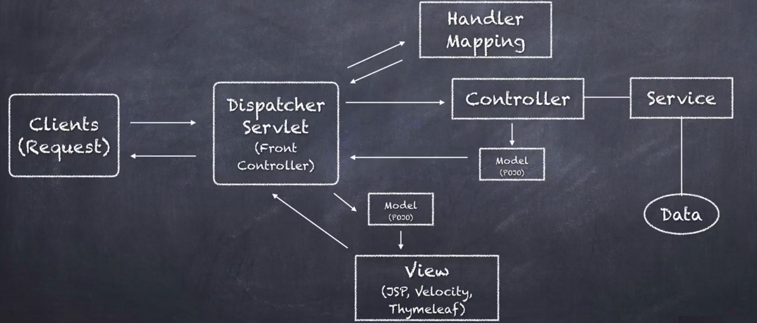
SPRING MVC

Slide 12
THYMELEAF
Thymeleaf is a Template Engine producing XML, XHTML,HTML5.
Open Source Project released in 2011.
Thymeleaf is a ‘Natural’ Template Engine.
Thymeleaf templates are valid HTML document.
Speeds development time.

Slide 13
HTTP Request methods
Request methods, also known as verbs, are used to indicate the desired action to be performed.
Following are the Request methods :-
GET
HEAD
POST
PUT
DELETE
OPTIONS

Slide 14
JPA
JPA is a specification that facilitates object-relational mapping to manage relational data in java applications.
Enterprise applications performs database operations by storing vast amount of data. With JPA the burden of interacting with database reduces significantly.
Types of Relationships :-
One to One (E.g employee, address)
One to Many (E.g question, answer)
Many to One (E.g employee, address)
Many to Many (E.g class, teacher)

Slide 15
JPA
Unidirectional VS Bidirectional
Fetch Type
Lazy Fetch Type
Eager Fetch Type
JPA Cascade Types – Control how state changes are cascaded
JPA Cascade Types:-
Persist
Merge
Refresh
Remove
All

Slide 16
Inheritance types
Single Table – One table is used to store attributes of instances of multiple entity classes.
Joined Table – Separate table is generated for every entity class.
Table per Class – For each sub entity class table is generated but no table is generated for parent entity.

Slide 17
Lombok
Raw source code is passed to Lombok for code generation before java continues.
Produces properly compiled Java code in conjunction with Java compiler.
Feature :-
@Getter
@Setter
@ToString
@NoArgsConstructor
@Data
@Builder

Slide 18
Exception handling
@ResponseStatus
@ExecptionHandler
Data Validation

Slide 19
QUESTIONS ?

Slide 20
Thanks

